Slide 1
Proposal presentation – commodity price forecasting
Team 9 – Rade Bajic – Eddie Morrissey – Nurly Kuzdikbay – David Basler – Stijn Jorissen

Slide 2
INTRODUCTION – why commodity prices
Commodity prices have a big influence on general purchasing power
It is a method of investment
Influences profits in almost all production industries

Slide 3
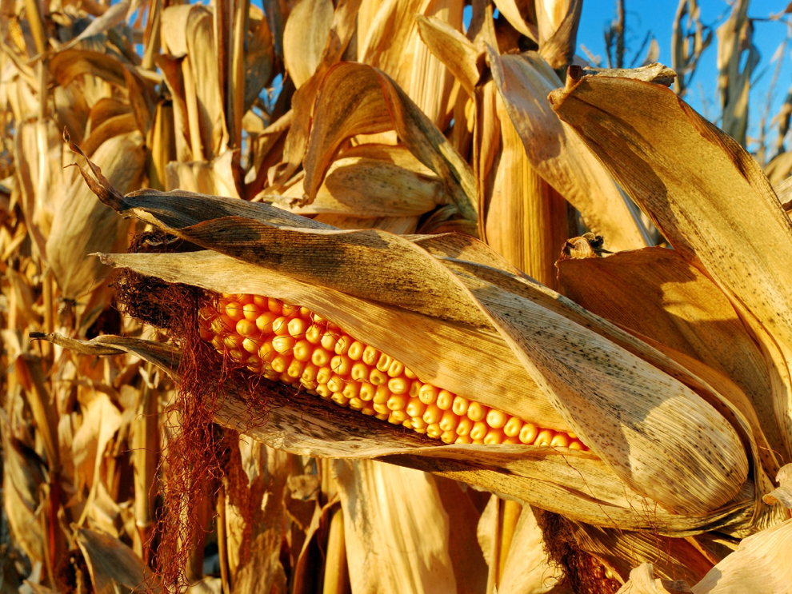
The research questions
Can historical price data and other indicators such as weather and macroeconomic data be used to build a reliable prediction model in order to forecast commodity price movement?
Are there key patterns in the price data to be incorporated?
What are the most important market indicators for commodity price forecasting?
To what extent does weather affect commodity prices?
What is the optimal forecast horizon?

Slide 4
Approach and hypothesis
Hypothesis : there will be a way to predict commodity prices better than general exponential smoothing
Weather will most likely be a factor in this
Energy prices will vary more with temperature
Food prices will vary more with precipitation amounts
Approach:
The initial approach will be using exponential smoothing/time series prediction
ARIMA models
Holt Winthers models
Random Forest/Logistic Regression
Deep learning
Addition of trending factors based on generally available data
Data availability
Weather, macroeconomic and commodity price data are all freely available
Data cleaning was needed to get to the same time periods and frames

Slide 5
Similar approaches
Inflation modelling has a strong correlation with commodity price modelling
‘Modelling inflation dynamics: A critical review of recent research’ states ‘sticky’ exponential smoothing models are creating worse predictions than models which accelerate based on other information
‘Can you predict commodity stock using a weather forecast’ on Medium uses granger causality tests to see if weather data is useful to predict commodity prtices
Mid to long term forecasting accuracy benefits from multivariate models, ‘Climate and environmental data contribute to the prediction of grain commodity prices using deep learning’

Slide 6
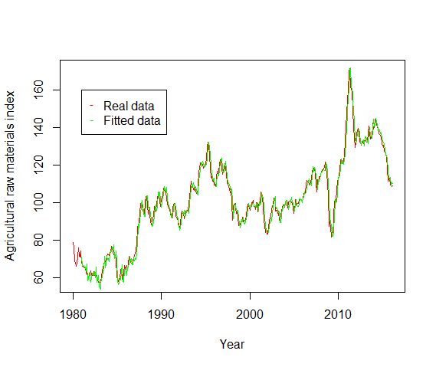
Basic Holt W inthers approach on the raw materials index
Basic Holt Winthers approach:
Seasonality: 1 year
Initialization:
Alpha = 0,2
Beta = 0.1
Gamma = 0.1
SSE: 4645

Slide 7
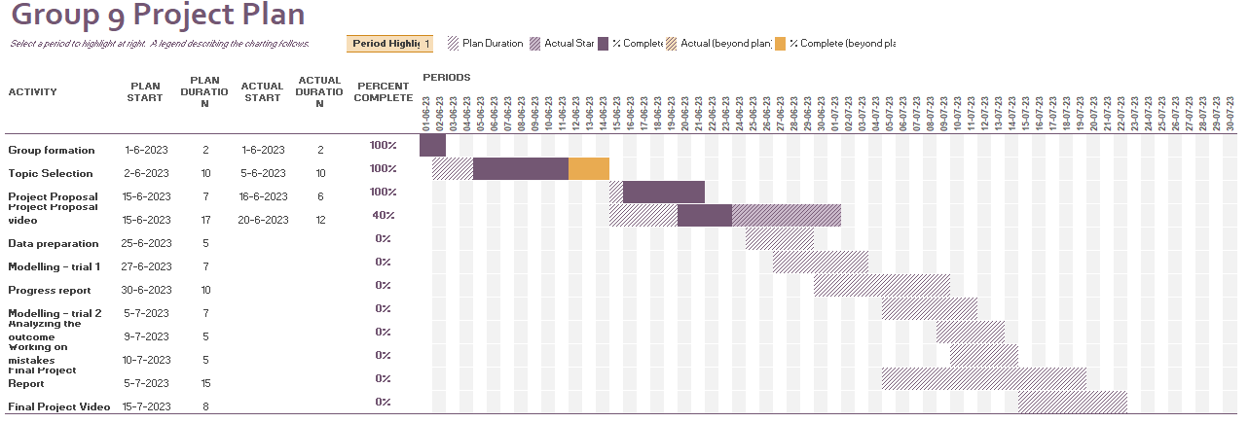
Project timeline/planning/forward looking
Focus now: fitting various models to find out what the best approach will be

Slide 8
Sources
Data:
Worldwide commodity prices:
Worldwide Commodity Prices | Kaggle
US weather data:
Search | Climate Data Online (CDO) | National Climatic Data Center (NCDC) (noaa.gov)
US Wages-Home prices – inflation data:
Consumer Price Index (CPI) Databases : U.S. Bureau of Labor Statistics (bls.gov)
Similar approaches:
(PDF) Modelling Inflation Dynamics: A Critical Review of Recent Research (researchgate.net)
Can you predict commodity stocks using a weather forecast? | by I. Colbert | Medium
Climate and environmental data contribute to the prediction of grain commodity prices using deep learning

